Slide 1
Moving to a World Beyond p<0.05
Ron Wasserstein
Executive Director
American Statistical Association
May 31, 2024
Milwaukee Chapter Annual Meeting
DISCLAIMER:
I am here today speaking as an individual researcher and not in my capacity as Executive Director.
So, blame me, and not the ASA, for anything I say that you don’t buy!

Slide 2
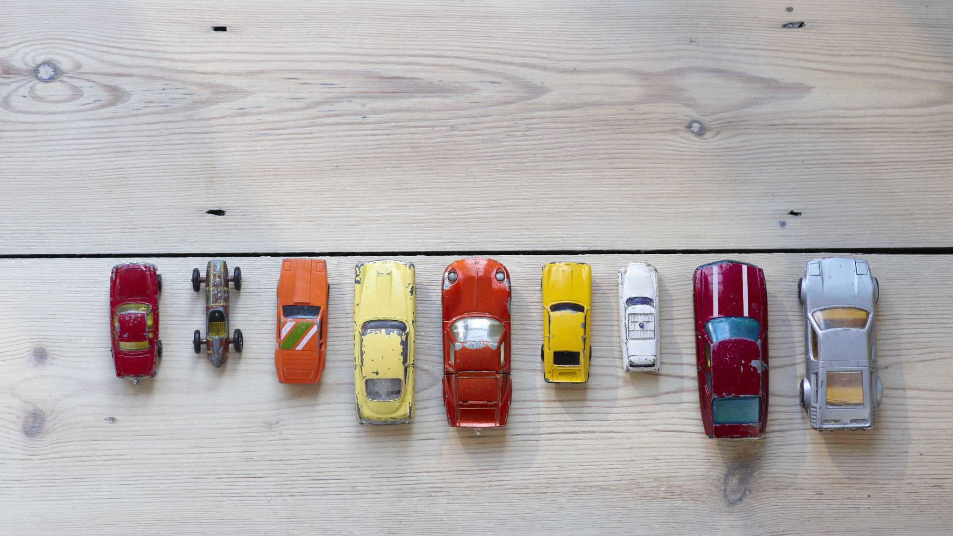
Imagine the car you would have if money were no object

Slide 4
“Shaken, not stirred”
“Sometimes it's not about being fast.”
"He stole John Wick’s car, sir. And, uhhh, killed his dog."
“Just remember this – in this country they drive on the wrong side of the rode.”
“Witness me”

Slide 6
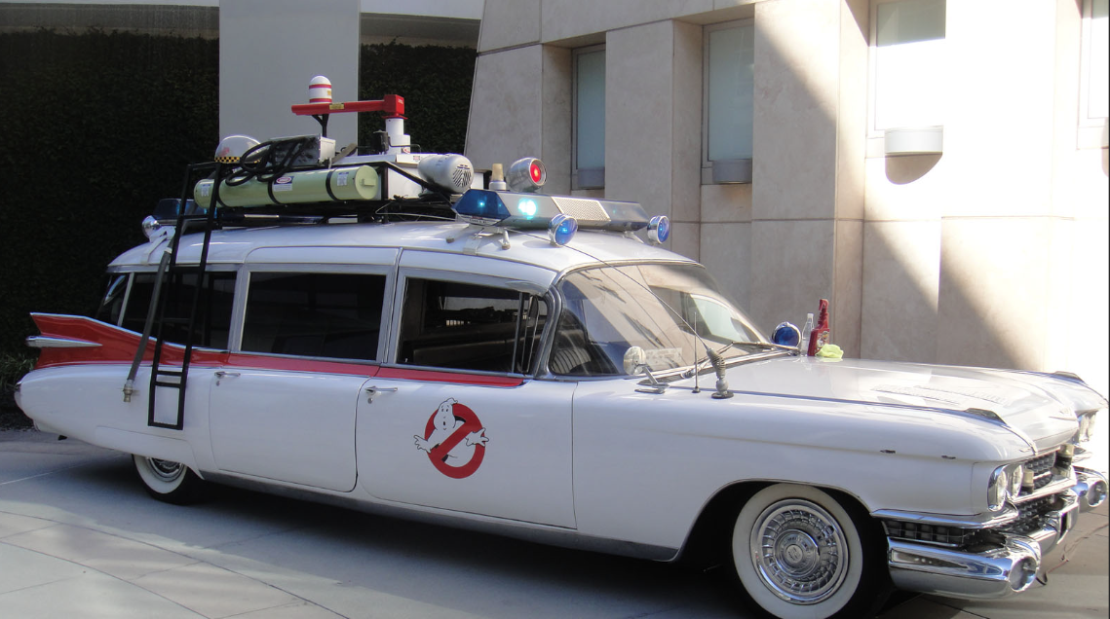
“Who you gonna call?
“I am Iron Man”
"What about the accent? Is it... is it too much?"
"It's not who I am underneath, but what I do that defines me.” "
“Ka-Chow!”

Slide 7
“Are you telling me you built a time machine…out of a Delorean?”

Slide 8
Suppose we had the most amazing car ever…
Beautiful
Energy efficient
Everyone has access to it
But…it turns out to be difficult to drive

Slide 9
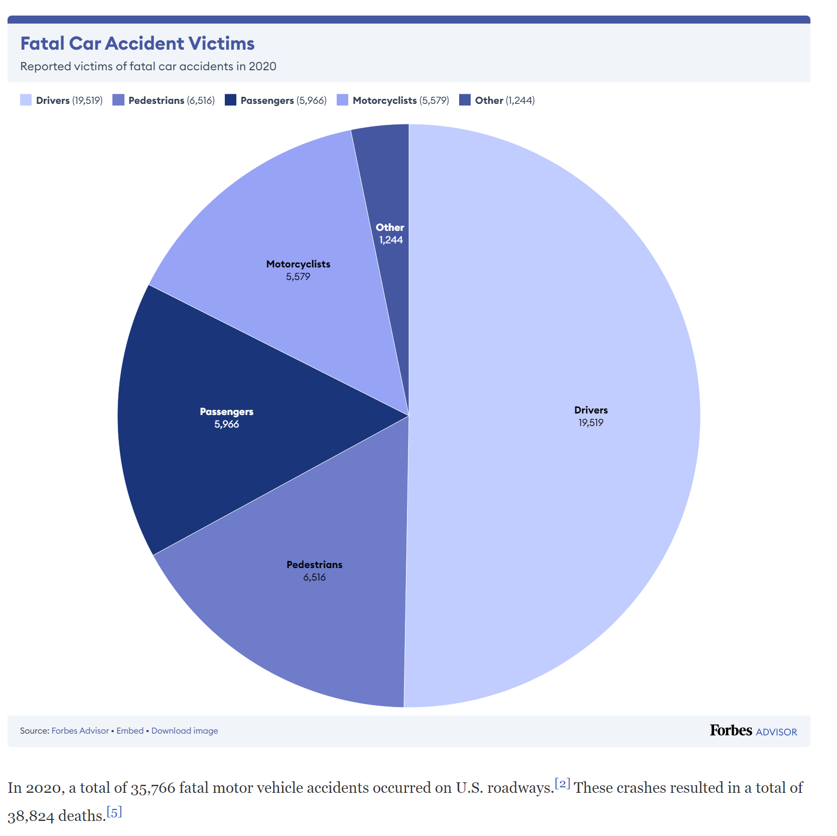
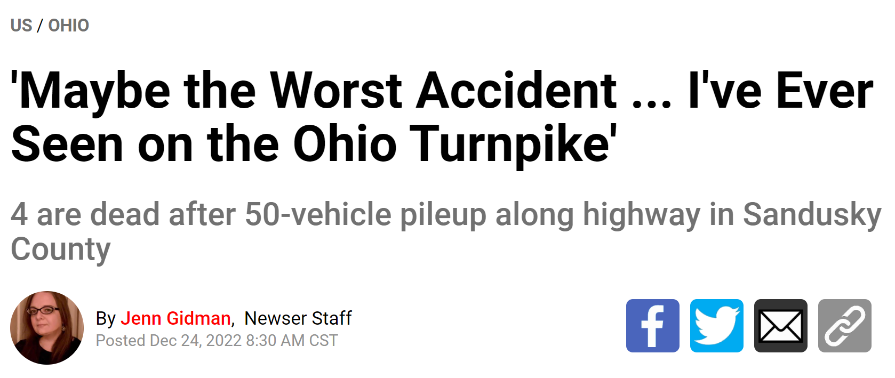
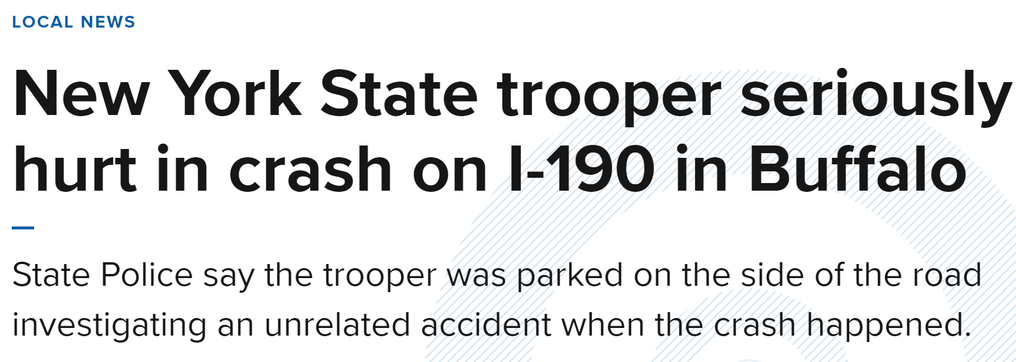
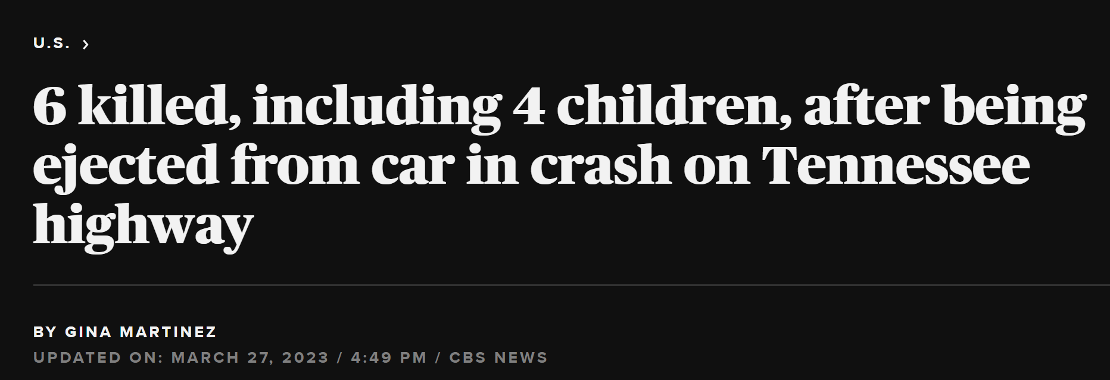

Slide 10
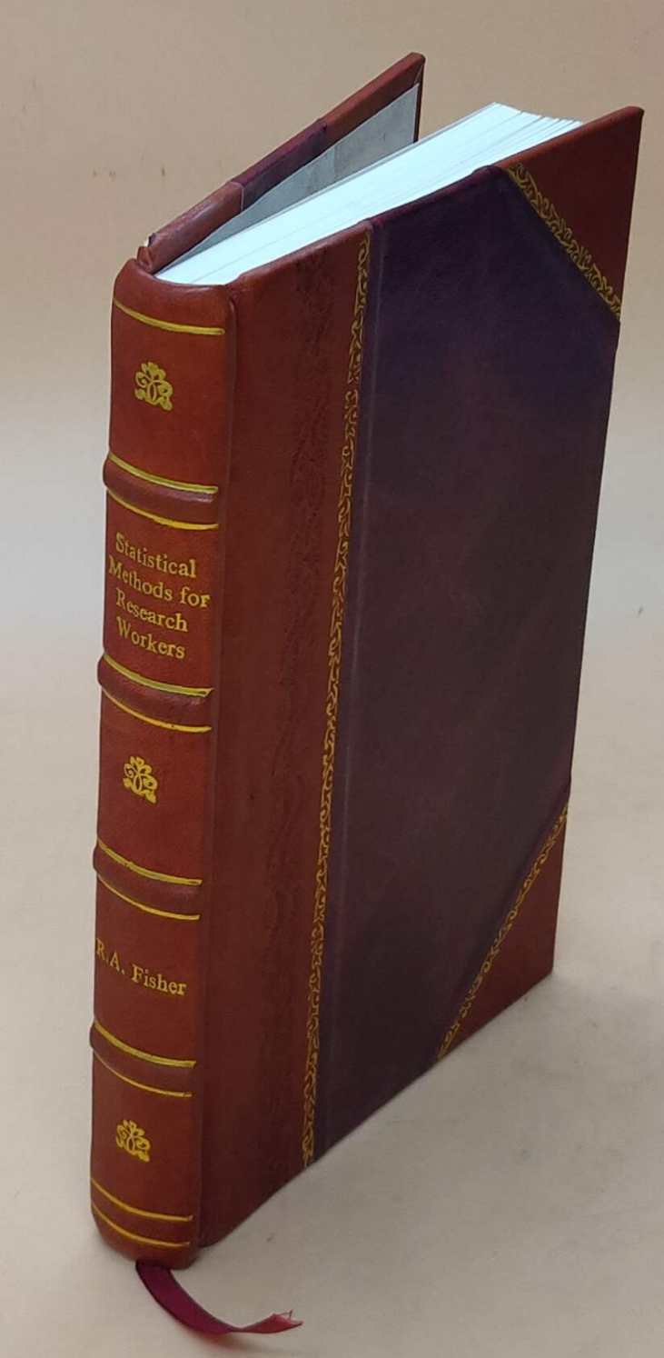
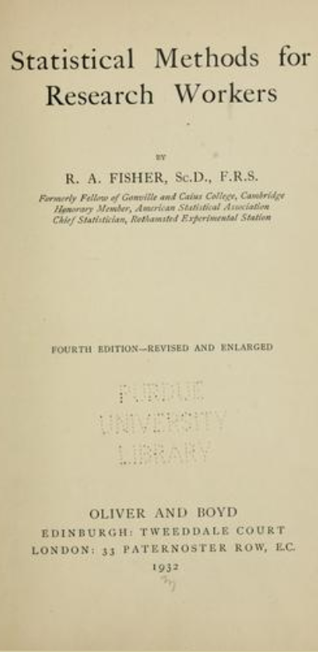
We have been test driving statistical significance for almost 100 years

Slide 11
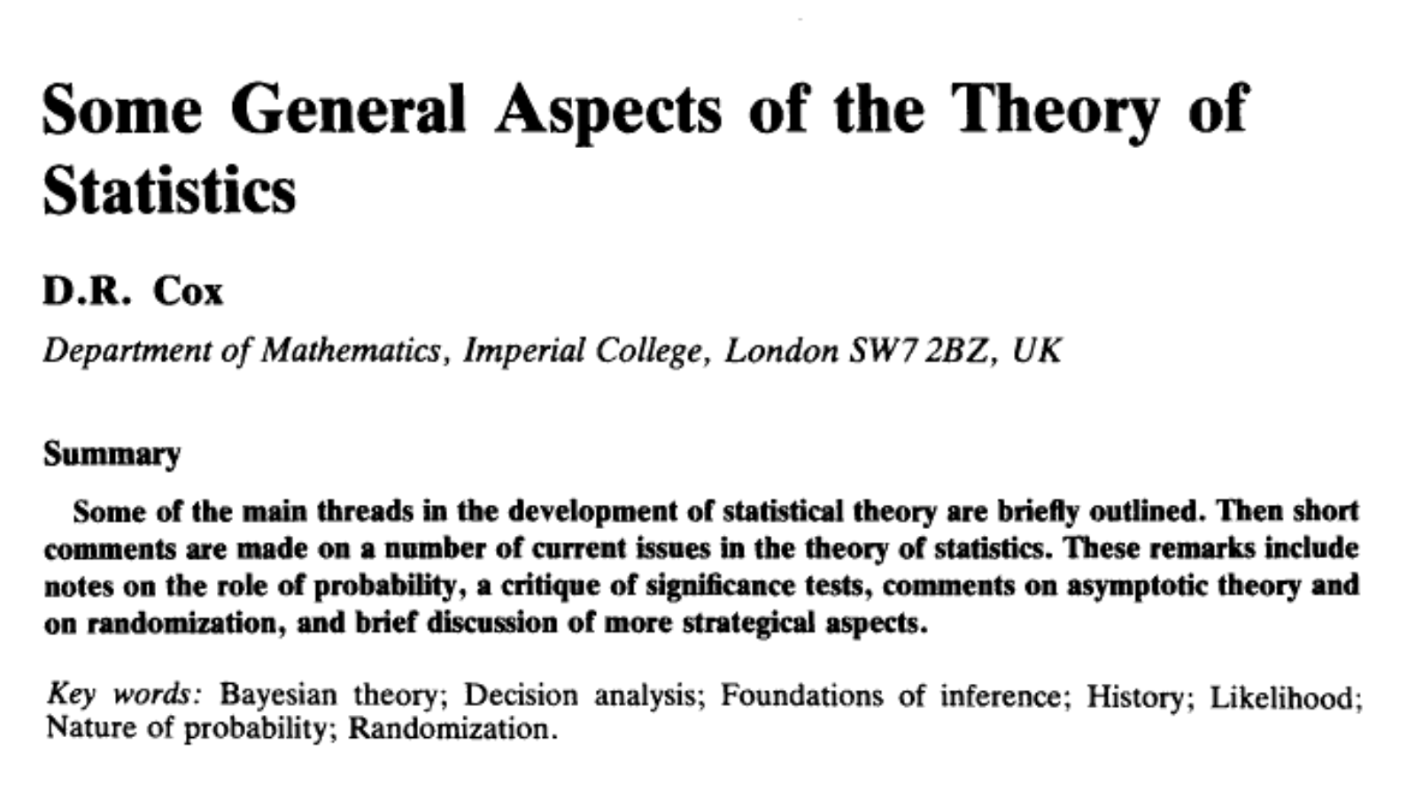
"It has been widely felt, probably for thirty years and more, that significance tests are overemphasized and often misused and that more emphasis should be put on estimation and prediction.”
Cox, D.R. 1986. Some general aspects of the theory of statistics. International Statistical Review 54: 117-126.

Slide 12
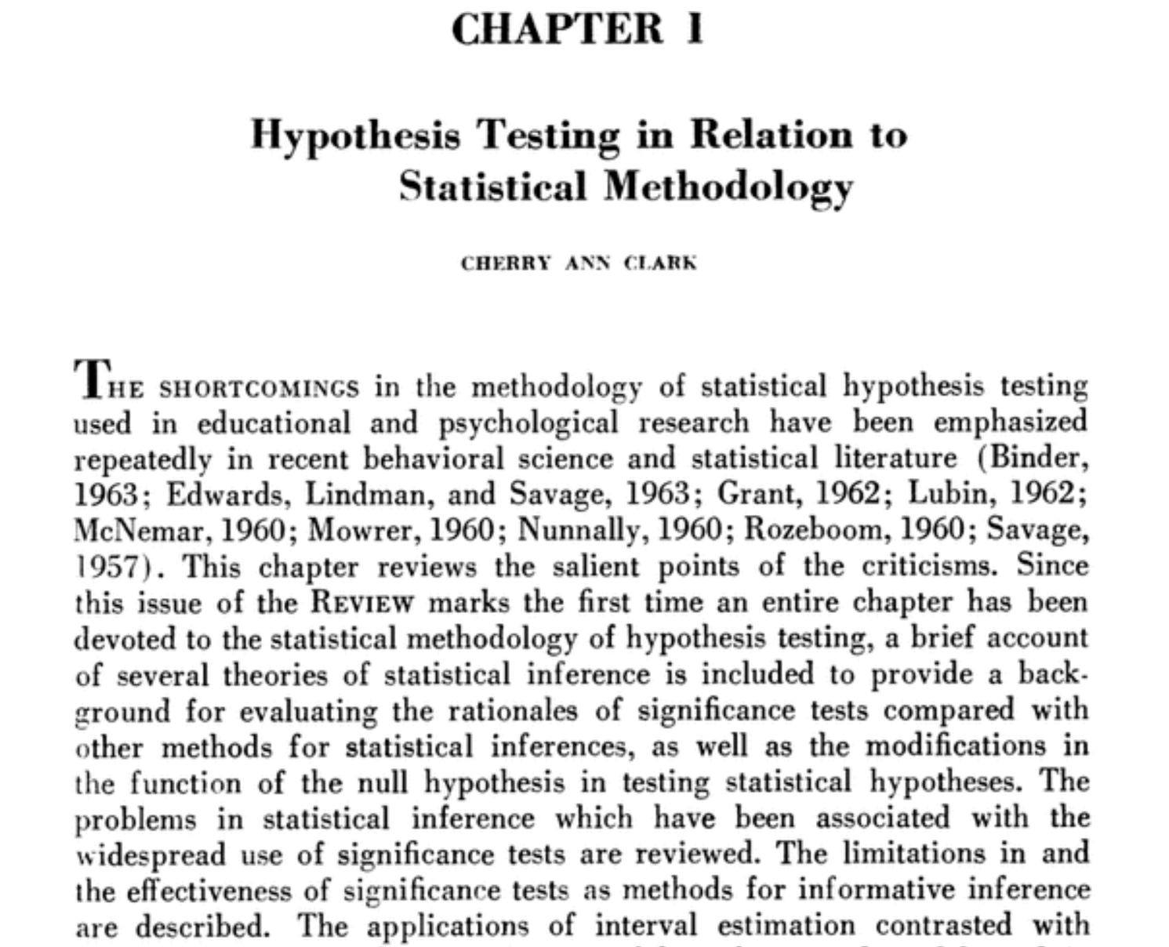
The null hypothesis of no difference has been judged to be no longer a sound or fruitful basis for statistical investigation. […] Significance tests do not provide the information that scientists need, and, furthermore, they are not the most effective method for analyzing and summarizing data.“
Cherry A Clark, "Hypothesis Testing in Relation to Statistical Methodology", Review of Educational Research Vol. 33, 1963

Slide 13
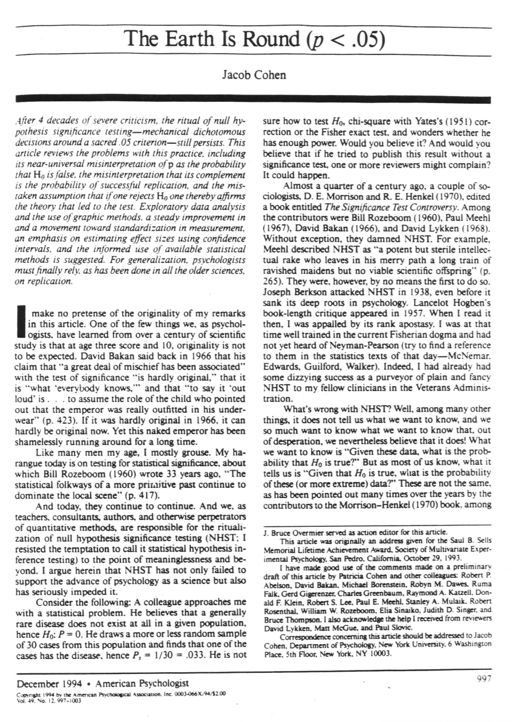
What's wrong with NHST? Well, among many other things, it does not tell us what we want to know, and we so much want to know what we want to know that, out of desperation, we nevertheless believe that it does!
Cohen, J. (1994). The earth is round (p < .05). American Psychologist, 49(12), 997–1003. https://doi.org/10.1037/0003-066X.49.12.997

Slide 14
At some point we should realize that more driver education is not going to do the trick!

Slide 15
More “driver education” has done nothing to stem use and misuse
Hubbard shows that the number of citations of articles critical of significance testing or warning of its dangers has grown over the last six decades, but at the same time the percentage of papers in many disciplines that use it has also considerably increased.

Slide 16
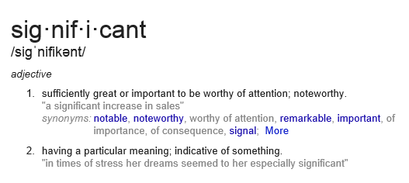
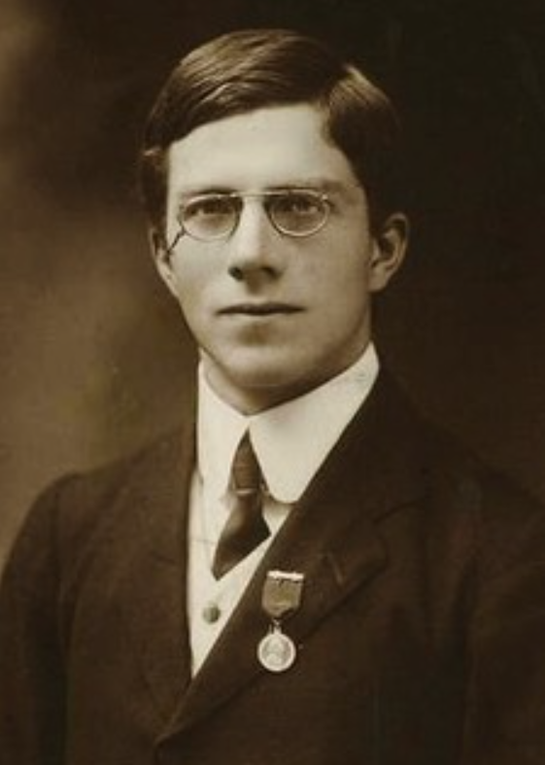
R. A. Fisher called such results “significant”
To Fisher, this meant that the result was worth further scrutiny.

Slide 17
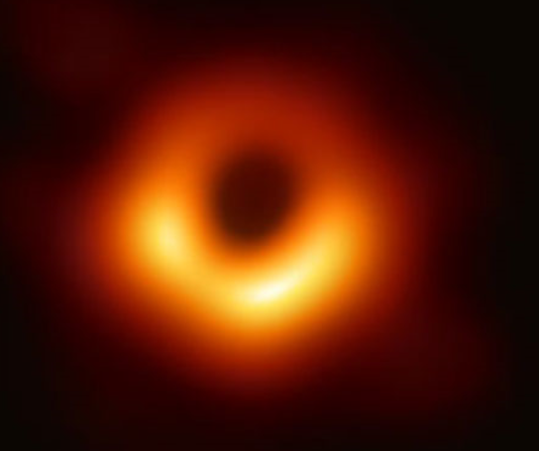
insignificant
unimportant
meaningless

Slide 18
significant increase
significant event
significant other

Slide 19
mole
The amount or sample of a chemical substance that contains as many constitutive particles, e.g., atoms, molecules, ions, electrons, or photons, as there are atoms in 12 grams of carbon-12

Slide 20
“You keep using that word. I don’t think that it means what you think it means.” – Inigo Montoya
“Just a Theory”: 7 Misused Scientific Words, Scientific American, April 2, 2013 https://www.scientificamerican.com/article/just-a-theory-7-misused-science-words/

Slide 21
Word #1
Hypothesis
A proposed explanation that can be tested

Slide 22
Word #2
Theory
An explanation of some aspect of the natural world that has been substantiated through repeated experiments or testing

Slide 23
Word #6
Significant

Slide 24
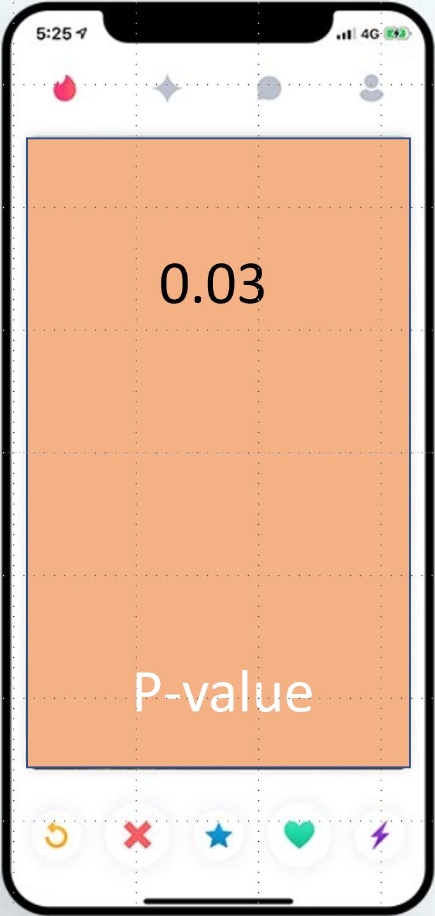

Slide 25
My experimental results are interesting. I should spend more time with them, maybe repeat the experiment. I may be on to something, but it will take time to be sure.

Slide 26
You tiny, beautiful p-value. You are the result that I want to spend the rest of my life with. Let’s publish and get grants together.
I love you!

Slide 27
A word about thresholds

Slide 28
Boundary lines
Boundary | Arbitrary | Rational
Necessary
Unnecessary

Slide 29
Boundary lines
Boundary | Arbitrary | Rational
Necessary | Soccer
Unnecessary

Slide 30
Boundary lines
Boundary | Arbitrary | Rational
Necessary | Soccer | Property
Unnecessary

Slide 31
Boundary lines
Boundary | Arbitrary | Rational
Necessary | Soccer | Property
Unnecessary |  | Traffic lanes (in certain countries)

Slide 32
Boundary lines
Boundary | Arbitrary | Rational
Necessary | Soccer | Property
Unnecessary | p < 0.05 | Traffic lanes (in certain countries)

Slide 33
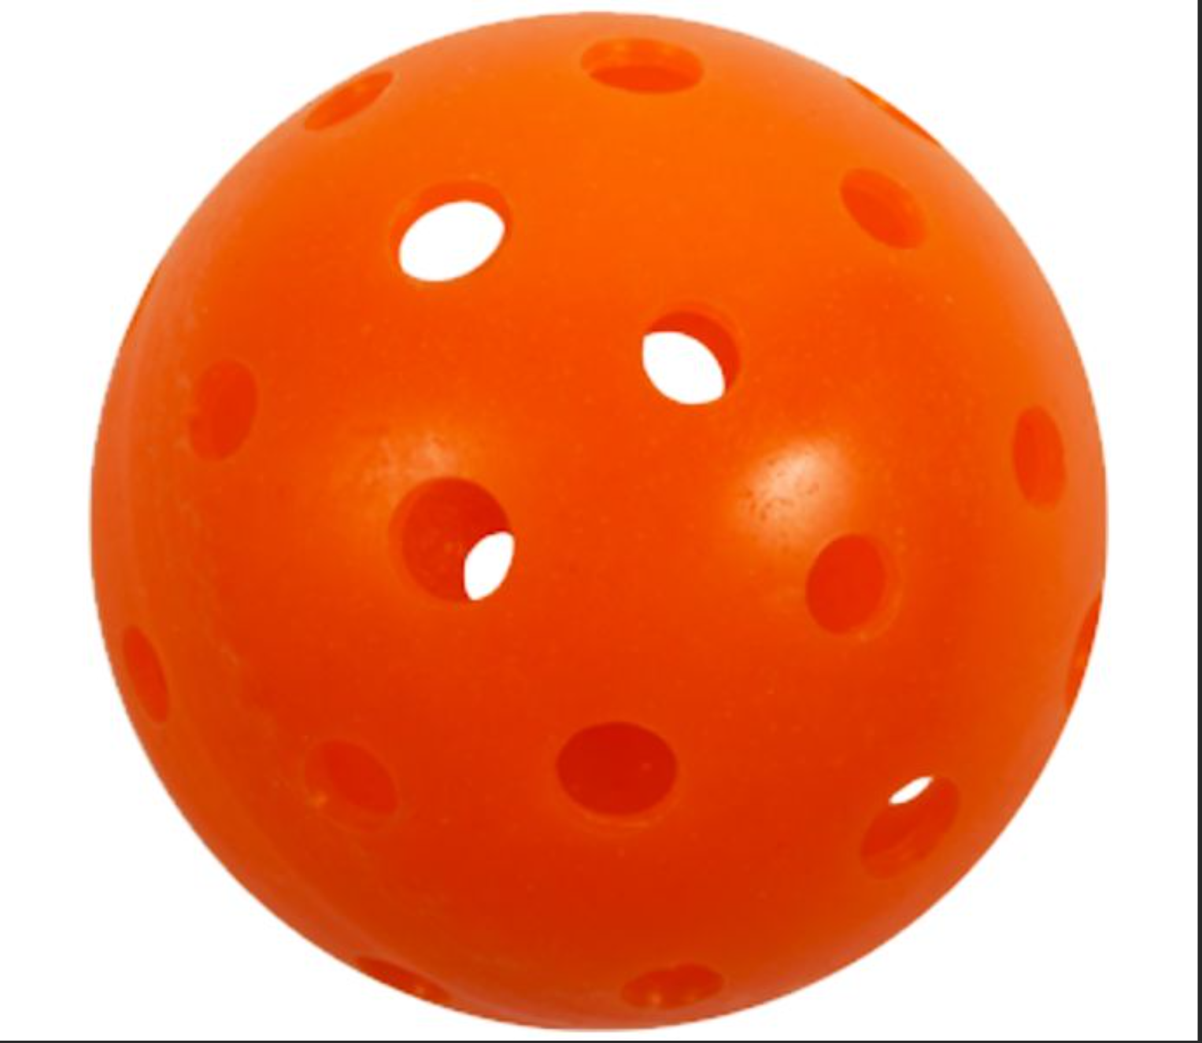
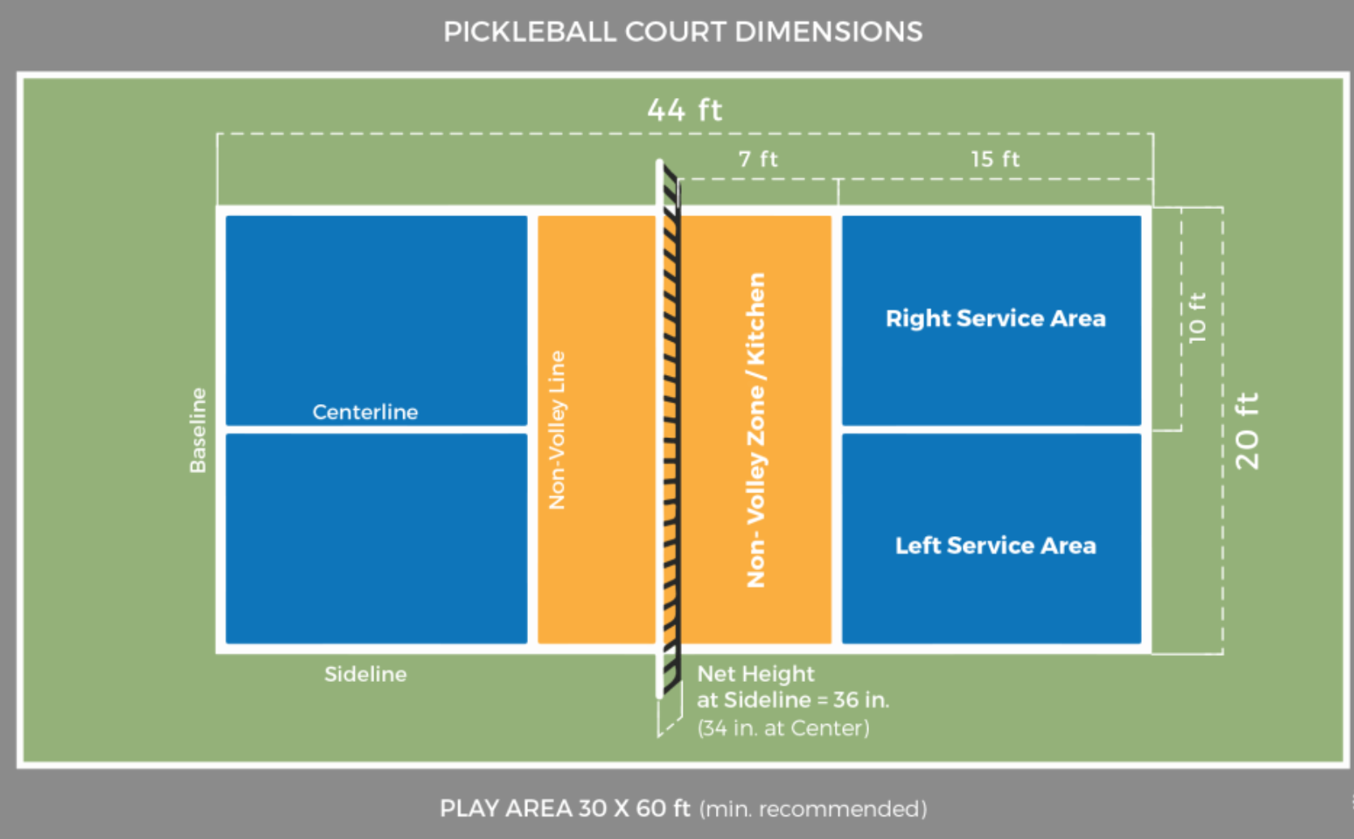
Boundary lines in sports
The ball is still in-bounds if it touches the line in
Baseball
Tennis
Soccer
Volleyball
Pickleball

Slide 34
Boundary lines in sports
The ball is out-of-bounds if it touches the line in
Football
Basketball

Slide 35
These boundaries are integral to the play of the game
Landing outside the boundary produces a very different outcome than landing inside
They are arbitrary but necessary boundaries
Arbitrary: established over time by the history of the sport or the size of the playing area (soccer: 90-120m x 45-90m)
Necessary: The game needs the boundaries to regulate play

Slide 36
How about this boundary?
Is it arbitrary?
Is it necessary?
p > 0.05
p < 0.05

Slide 37
Landing outside THIS boundary also produces a very different outcome than landing inside
p > 0.05
Not true?
Scientifically meaningless?
Unmeritorious?
Not deserving of publication?
Not worth more attention?
True?
Scientifically meaningful?
Meritorious?
Deserving of publication?
Worth more attention?
p < 0.05

Slide 38
Arbitrary:
The boundary does not represent a consensus perspective on what indicates “merit” but is a convenience based on history.
THIS boundary is arbitrary, but it is unnecessary
p > 0.05
Unnecessary:
“Significant” does not mean that an observed effect is not due to chance. It also does not mean that the effect is real, genuine, important, true, or any of the other common misinterpretations.
p < 0.05

Slide 39
Declaration of statistical significance is usually an ending point and not just a starting point – leading to unreliable results and unwarranted claims.
p > 0.05
THIS boundary is arbitrary, but it is unnecessary
A declaration of statistical significance does not convey anything useful beyond what is conveyed by the p-value itself. It adds no new evidence.
p < 0.05

Slide 40
Bright line thinking
The problem with using bright lines is that they inevitably lead to our treating results on opposite sides of the line very differently, even if their practical implications are identical.
Moreover, having such a rule establishes how to achieve a desired outcome by manipulation, and unfortunately, once achieved, that result usually gains more weight than is deserved.
“... we only wish to emphasize that dichotomous significance testing has no ontological basis. That is, we want to underscore that, surely, God loves the .06 nearly as much as the .05.”
Rosnow, R.L. and Rosenthal, R. 1989. Statistical procedures and the justification of knowledge and psychological science. American Psychologist 44: 1276-1284

Slide 41
p equal or nearly equal to 0.06
almost significant
almost attained significance
almost significant tendency
almost became significant
almost but not quite significant
almost statistically significant
almost reached statistical significance
just barely below the level of significance
just beyond significance.
Notes:
If you think bright-line thinking is not going on, and that it isn’t clustered around 0.05, consider these quotes, taken from actual research articles
Rosnell, R.L. and Rosenthal, R. 1989. Statistical procedures and the justification of knowledge and psychological science. American Psychologist 44: 1276-1284

Slide 42
p equal or nearly equal to 0.08
a certain trend toward significance
a definite trend
a slight tendency toward significance
a strong trend toward significance
a trend close to significance
an expected trend
approached our criteria of significance
approaching borderline significance
approaching, although not reaching, significance.
Notes:
If you think bright-line thinking is not going on, and that it isn’t clustered around 0.05, consider these quotes, taken from actual research articles
Rosnell, R.L. and Rosenthal, R. 1989. Statistical procedures and the justification of knowledge and psychological science. American Psychologist 44: 1276-1284

Slide 43
p close to but not less than 0.05
hovered at nearly a significant level (p=0.058)
hovers on the brink of significance (p=0.055)
just about significant (p=0.051)
just above the margin of significance (p=0.053)
just at the conventional level of significance (p=0.05001)
just barely statistically signiﬁcant (p=0.054)
just borderline significant (p=0.058)
just escaped significance (p=0.057)
just failed significance (p=0.057).

Slide 44
Thanks to Matthew Hankins for these quotes
https://mchankins.wordpress.com/2013/04/21/still-not-significant-2/

Slide 46
“Moving to a World Beyond p<0.05” https://amstat.tandfonline.com/doi/full/10.1080/00031305.2019.1583913#.XYjKQ25FxPY “Scientists rise up against statistical significance” https://www.nature.com/articles/d41586-019-00857-9
It’s time to say farewell to “statistically significant”

Slide 47
Significance has lost its meaning
Bright lines lead to bizarre behavior
Decades of complaining have done nothing
“A label of statistical significance adds nothing to what is already conveyed by the value of p; in fact, this dichotomization of p-values makes matters worse.” (TAS editorial)
Multiple analyses
File drawer effect

Slide 48
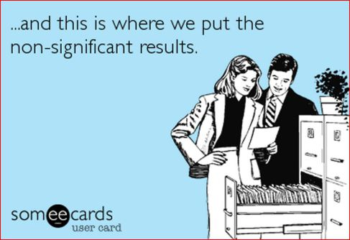
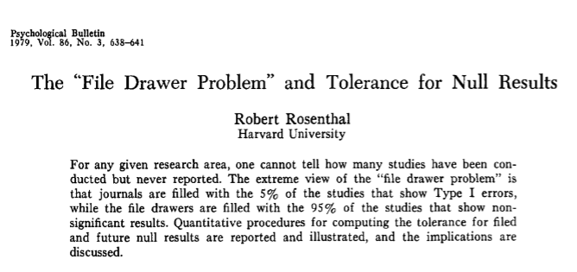
http://datacolada.org/wp-content/uploads/2016/12/3386-Rosenthal-1979-The-file-drawer-problem-and-tolerance-for-null-results.pdf
48

Slide 49
Change is needed… …but change is never easy
“The basic explanation is neither philosophical nor scientific, but sociologic; everyone uses them. It’s the same reason we can use money. When everyone believes in something’s value, we can use it for real things; money for food, and p-values for knowledge claims, publication, funding, and promotion. It doesn’t matter if the p-value doesn’t mean what people think it means; it becomes valuable because of what it buys.” (Goodman – 2019 (TAS))

Slide 50
Before listing some changes, though, let’s be sure to note that there are…

Slide 51
Opposing views
Potentially creates anarchy
Negatively impacts image of statistics
Why pick on p-values?
Decisions have to be made

Slide 52
1. Ending Significance Creates “The Wild West”

Slide 53
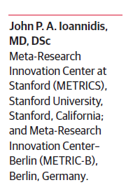
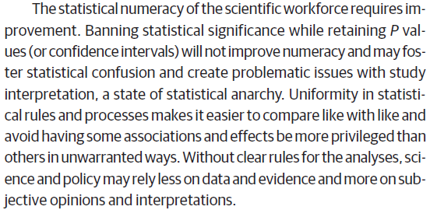

Slide 54
This argument does not address any of the shortcomings of the use of statistical significance. Is the way to avoid “statistical anarchy” by using a problematic method?

Slide 55
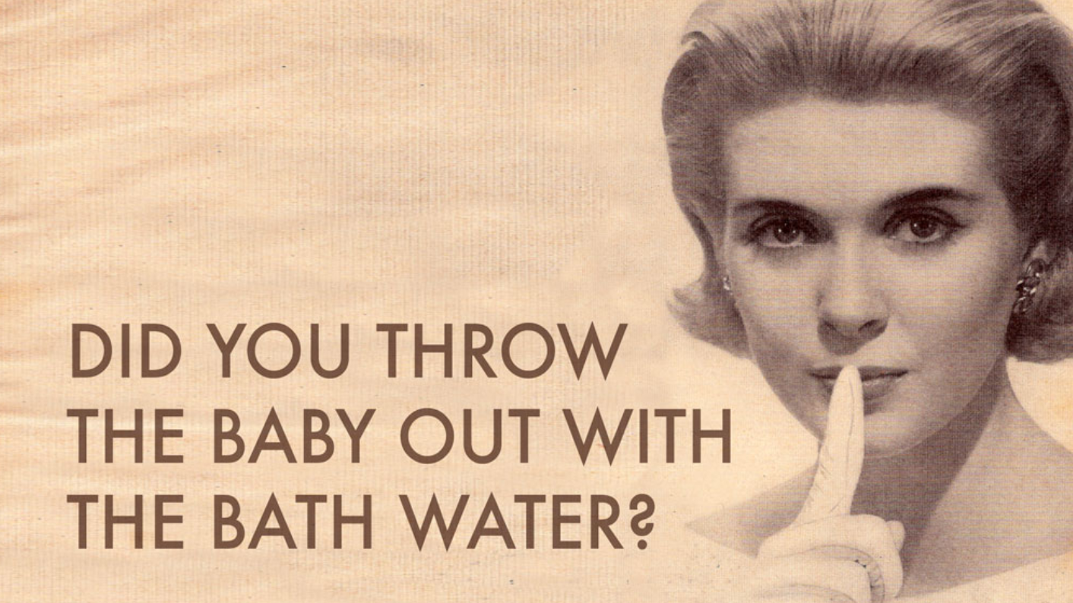
2. Ending significance negatively influences the perception of our profession

Slide 56
ASA President’s Corner
“…researchers may read the call to ‘abandon statistical significance’ as ‘abandon statistical methods altogether’.”
https://magazine.amstat.org/blog/2019/06/01/unintended-consequences/

Slide 57
Does keeping the baby (statistics) in the bathwater (significance) make sense? That bathwater has needed changed for 100 years!

Slide 58
“It’s the Same Old Song”
3. Everything we are saying about statistical significance could be true for other statistical measures as well.

Slide 59
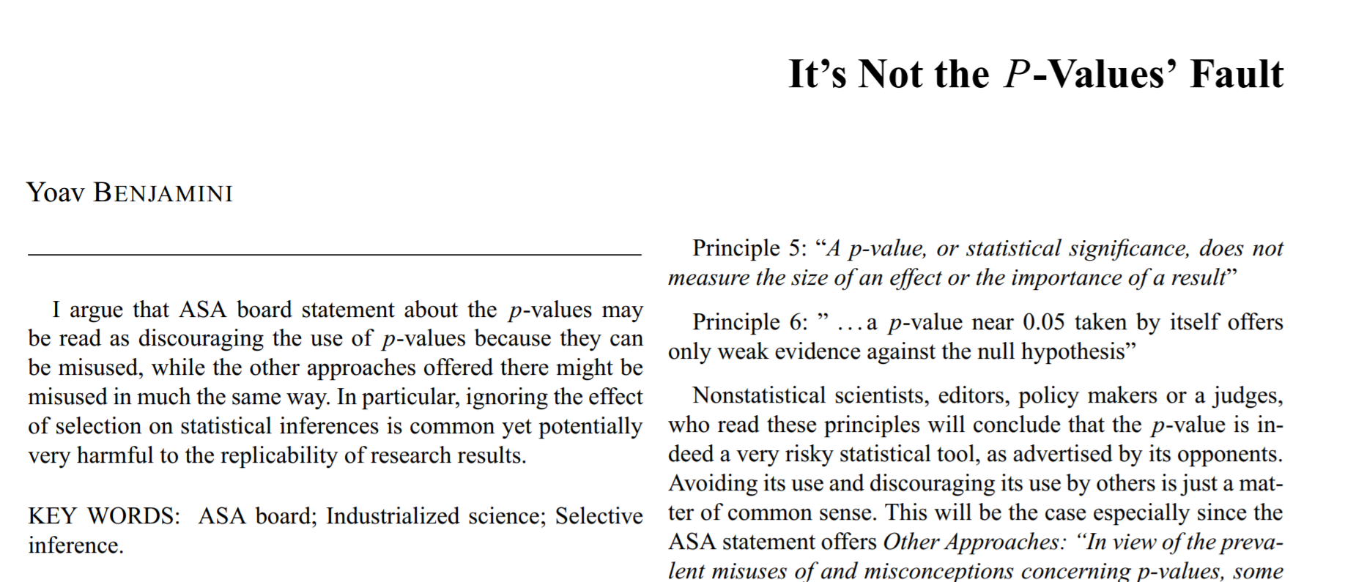
Other methods have the same problems
Benjamini, Y. Online discussion of the ASA Statement on Statistical Significance and P-Values, The American Statistician, 70.
“Yet all of these other approaches, as well as most statistical tools, may suffer from many of the same problems as the p-values do. What level of likelihood ratio in favor of the research hypothesis will be acceptable to the journal? Should scientific discoveries be based on whether posterior odds pass a specific threshold (P3)? Does either measure the size of an effect (P5)?”

Slide 60
“It’s the Same Old Song”
True!
But that doesn’t imply that we should keep using a method that we KNOW has been abused for decades because other methods could be similarly abused.

Slide 61
4. Decisions have to be made

Slide 62
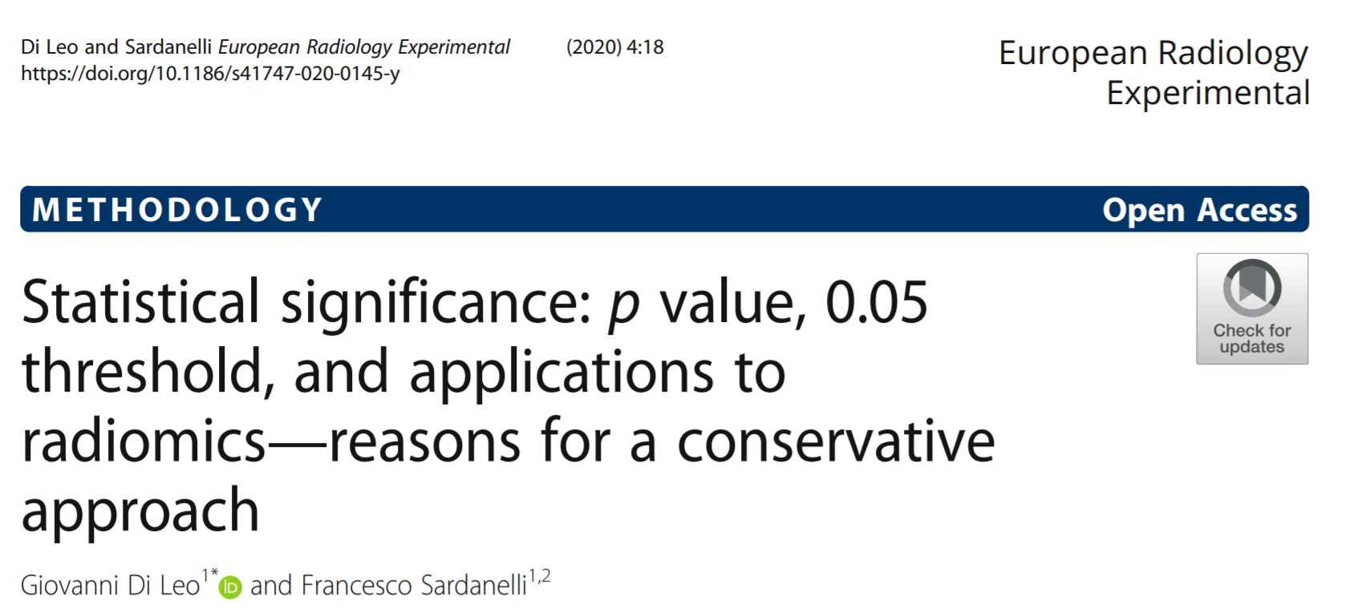
We acknowledge the importance of embracing uncertainty, avoiding hyped claims, and recognising that the p value is often poorly understood, but statistical significance, in our opinion, has a crucial practical importance. Inferences are unavoidably dichotomous, especially in medicine and healthcare, both in preclinical (experimental) and clinical research.

Slide 63
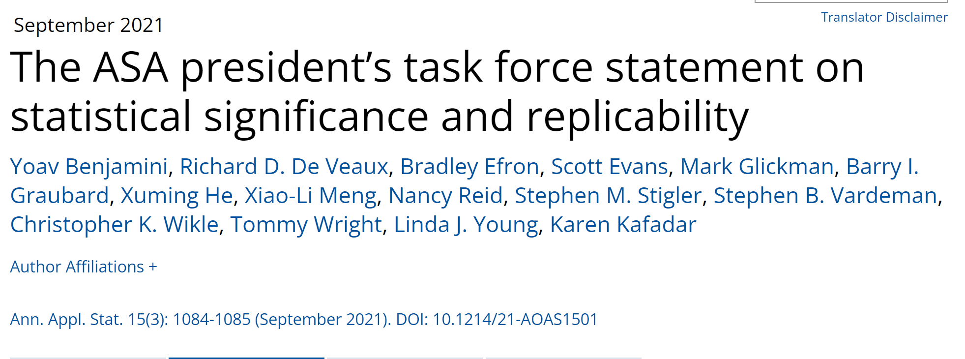
ASA Task Force statement
“Its purpose is two-fold: to clarify that the use of P -values and significance testing, properly applied and interpreted, are important tools that should not be abandoned, and to briefly set out some principles of sound statistical inference that may be useful to the scientific community.”

Slide 64
“Thresholds are helpful when actions are required. Comparing P-values to a significance level can be useful…. If thresholds are deemed necessary as a part of decision-making, they should be explicitly defined based on study goals, considering the consequences of incorrect decisions. Conventions vary by discipline and purpose of analyses.” [highlighting in original]

Slide 65
“Thresholds are helpful when actions are required. Comparing P-values to a significance level can be useful…. If thresholds are deemed necessary as a part of decision-making, they should be explicitly defined based on study goals, considering the consequences of incorrect decisions. Conventions vary by discipline and purpose of analyses.” [highlighting in original]

Slide 66
4. Decisions have to be made
Decisions might be dichotomous. But strength of evidence is not.
And though we know thresholds “should be explicitly defined based on study goals, considering the consequences of incorrect decisions,” that’s not what researchers do.

Slide 67
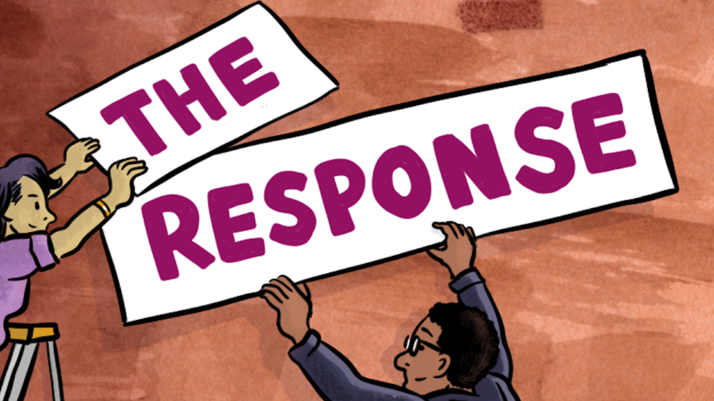
It is reasonable to ask:
Do we overstate what statistics can produce when we make these arguments?
Image from The Response - Free Speech TV

Slide 68
What do we do instead?
If we are telling everyone to stop using thresholds to interpret p-values, what should we do?
Look for some answers in the March 2019 special issue of The American Statistician (online and open access)
We’ll talk about a few here, but…
As you think about moving to a world beyond p<0.05, ask yourself: “If this arbitrary threshold had never been created, what would you have to do to get your paper published, your research grant funded, your drug approved, your policy or business recommendation accepted?”

Slide 69
Five changes that could be made relatively easily
(1) Lead with (focus on) effect sizes and related measures of uncertainty (for instance, interval estimates)
(2) Focus on the substantive implications of those estimates.
(For example, don’t focus on whether the interval contains zero, but on whether the interval bounds have qualitatively different practical consequences.)

Slide 70
Five changes that could be made relatively easily
(3) Interpret confidence intervals as compatibility intervals (that is, describing how compatible the data are with your hypothesized model)

Slide 71
Example of compatibility interval interpretation
Study: Covid-19 patients received lopinavir–ritonavir in addition to standard care or standard care alone (randomized trial) (NEJM, March 18, 2020, DOI: 10.1056/NEJMoa2001282)
Result: Mortality difference at 28 days of –5.8 percentage points, 95% CI (–17.3, 5.7)
Conclusion: “Mortality at 28 days was similar in the lopinavir–ritonavir group and the standard-care group (19.2% vs. 25.0%). … In hospitalized adult patients with severe Covid-19, no benefit was observed with lopinavir–ritonavir treatment beyond standard care.”
71

Slide 72
Example of compatibility interval interpretation
A better statement of this result:
“Our estimate of the mortality difference at 28 days was –5.8 percentage points (= 19.2% – 25.0%); thus, adding lopinavir-ritonavir to standard care could result in a clinically large decrease in mortality. However, possible mortality differences that are highly compatible with our data, given our model, ranged from –17.3 (a very large decrease in mortality) to 5.7 (a large increase in mortality). Our trial was small, including only 199 patients, all with severe Covid-19. Further study of this potentially effective treatment is needed.”
This result should be discussed in the context of the plausibility of the causal mechanism for a beneficial effect (based on prior evidence), the high consistency of results across different study outcomes, study limitations (including but not limited to the large imprecision of the estimates), potential adverse effects of lopinavir-ritonavir, and other relevant considerations.

Slide 73
Five changes that could be made relatively easily
(4) When presenting p-values, present them as continuous values (not categorized into significant or not), and along with the standard p-value (null hypothesis), report p-values for other pre-specified hypotheses.
(One example: instead of assuming no effect, assume the minimum meaningful effect size.)

Slide 74
Five changes that could be made relatively easily
(5) Interpret p-values as (uncertain) descriptive measures of compatibility with the model, and recognize that the value of p is impacted not just by the assumption of the null hypothesis, but by the many other assumptions/choices data analysts make
(The Tinder example helps here in indicating not to rush to fall in love with a low p-value)

Slide 75
And one more change, a little harder, but maybe most important
Don’t focus on the statistical measure alone (for example, the p-value) but also consider
related prior evidence
plausibility of mechanism
study design and data quality
real world costs and benefits
novelty of finding
other factors that vary by research domain
(per McShane et al)

Slide 76
“If this arbitrary threshold had never been created, what would you have to do to get your paper published, your research grant funded, your drug approved, your policy or business recommendation accepted?”
My answer is that you would “have to science the sh*t out of this.” – Mark Watney The Martian

Slide 77
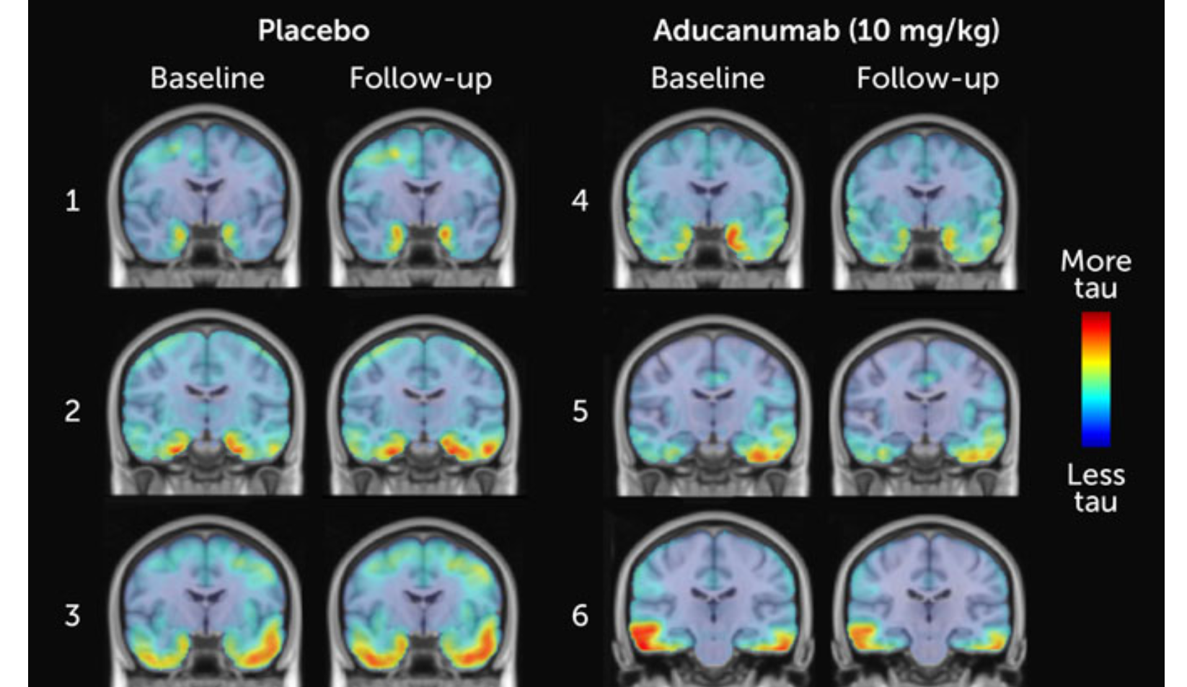
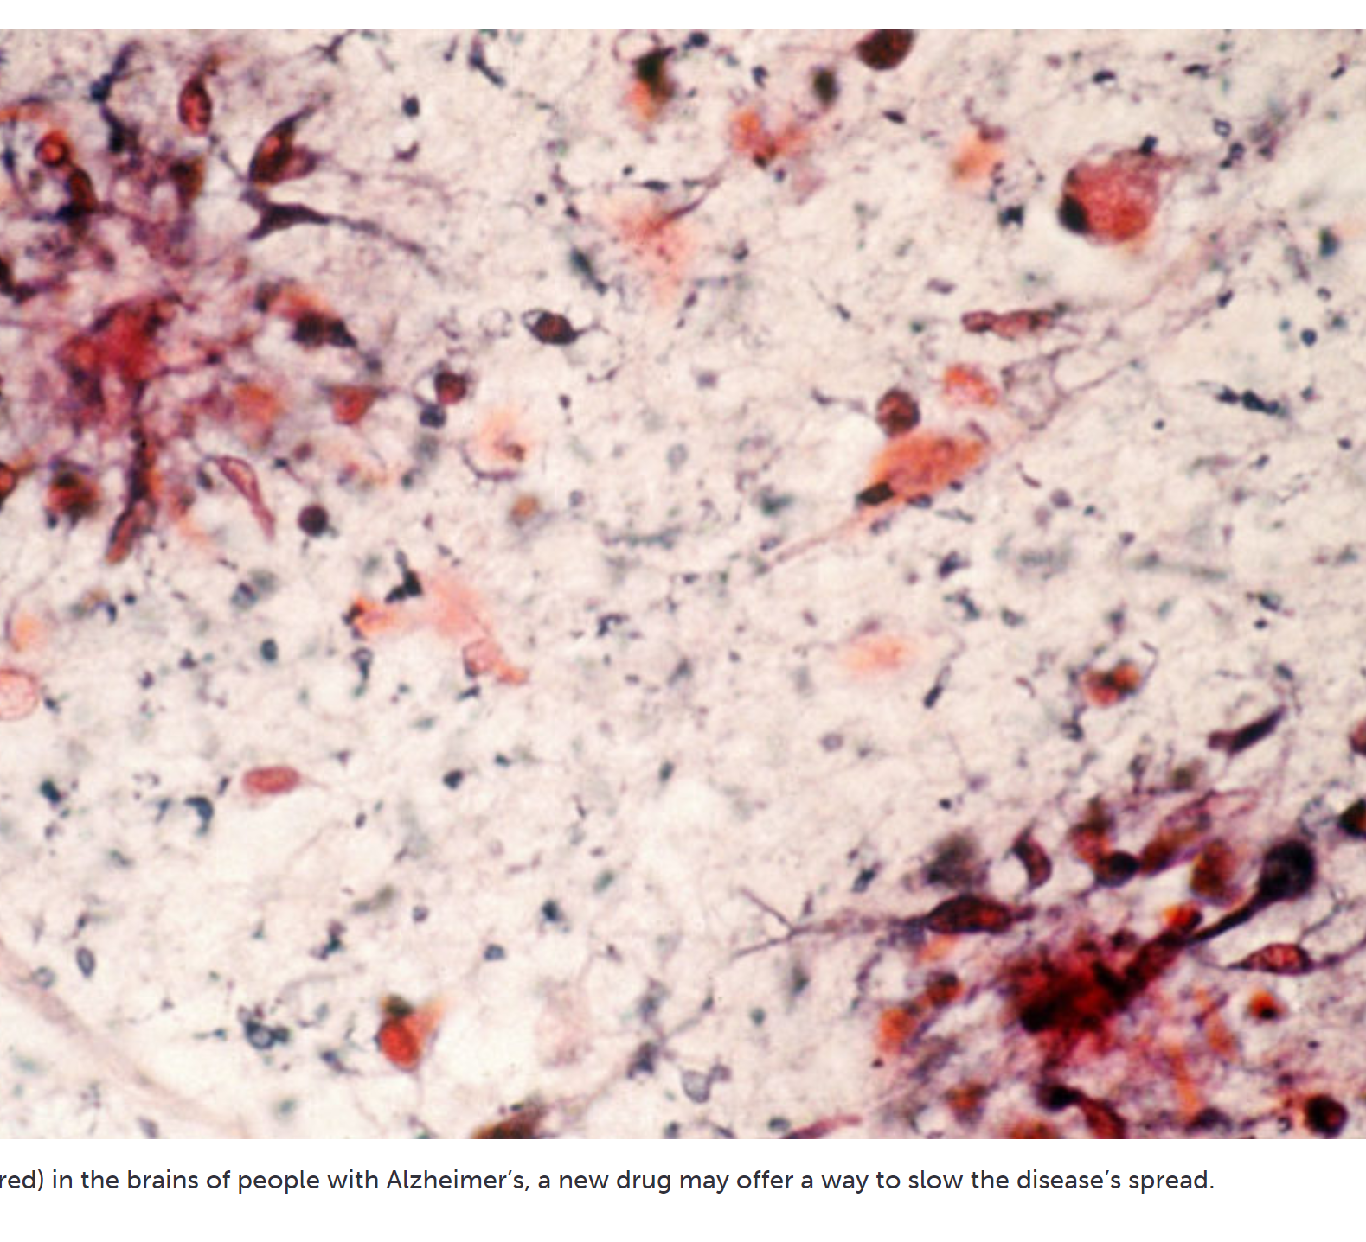
Why does this matter?
Aducanumab (Aduhelm) as a treatment for Alzheimer’s Disease
https://www.sciencenews.org/article/once-scrapped-alzheimers-drug-aducanumab-may-work-after-all

Slide 78
The plot elements
The drug aducanumab, an antibody, has been shown to remove amyloid clusters from the brain.
Such buildup on the brain is associated with Alzheimer’s Disease.
The question is whether removal of amyloids would reduce the effects of Alzheimer’s
No drug has thus far succeeded in reducing the effects

Slide 79
The plot elements
Biogen stopped two simultaneous clinical trials on the effectiveness of aducanumab in March 2019 after futility analysis indicated the study would not likely demonstrate efficacy.
“Between December 2018, when data were cut for the futility analysis, and March 2019, when the trials were discontinued, an additional 179 EMERGE and 139 ENGAGE participants completed 18 months of follow-up”
Howard, R., and Liu, K. Y. (2019), “Questions EMERGE as Biogen claims aducanumab turnaround,” Nature Reviews Neurology, 1–2. https://doi.org/10.1038/s41582-019-0295-9.
However, more data came in.

Slide 80
The plot elements
A subset analysis was undertaken of those participants who received the full, uninterrupted treatment
In ONE of the two trials, statistical significance was achieved. The higher dose led to 23% less cognitive decline than a placebo after 78 weeks.

Slide 81
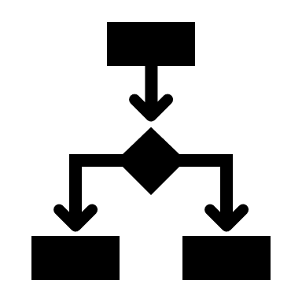
The plot thickens
Biogen argues that the difference in the results can be explained by a protocol change, but this is based on post hoc subgroup analysis, not the best place to focus on p-values
The effect sizes may not actually meet a threshold of clinical significance.

Slide 82
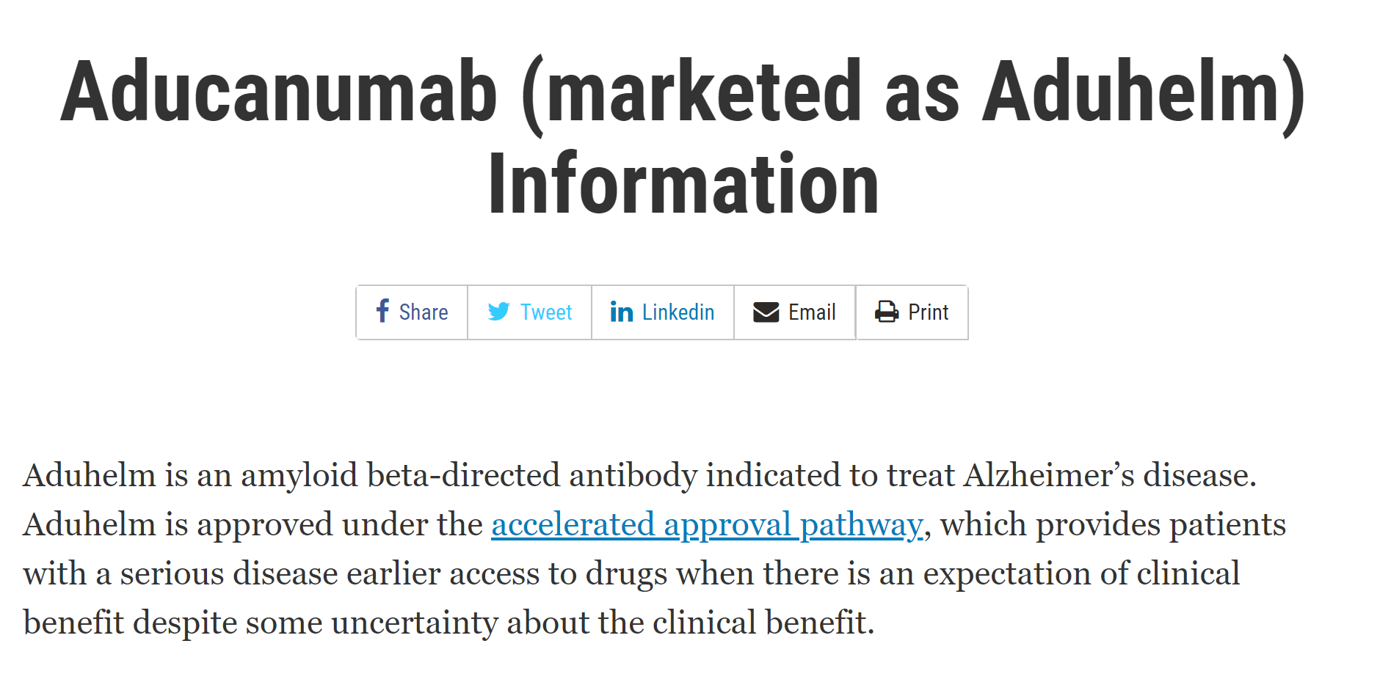
What happened? FDA approval (June 2021)
82

Slide 83
But an uproar arose
83

Slide 84
Statistical significance?
We’re not privy to all the internal workings
We aren’t experts (but the internal FDA committee members ARE)
Impact of focusing on a threshold – apparent p-hacking kept the product alive
Lots of money and hopes involved
Lecanemab (Leqembi) was approved in January 2023
“Still, several Alzheimer’s experts said it was unclear from the medical evidence whether Leqembi could slow cognitive decline enough to be noticeable to patients.” FDA Approves, Leqembi, New Treatment for Early Alzheimer’s - The New York Times (nytimes.com)

Slide 85
But then…
January 31, 2024 – Biogen stops tests and abandons the drug
https://www.nytimes.com/2024/01/31/business/biogen-alzheimers-aduhelm.html
And then March 7, 2024

Slide 86
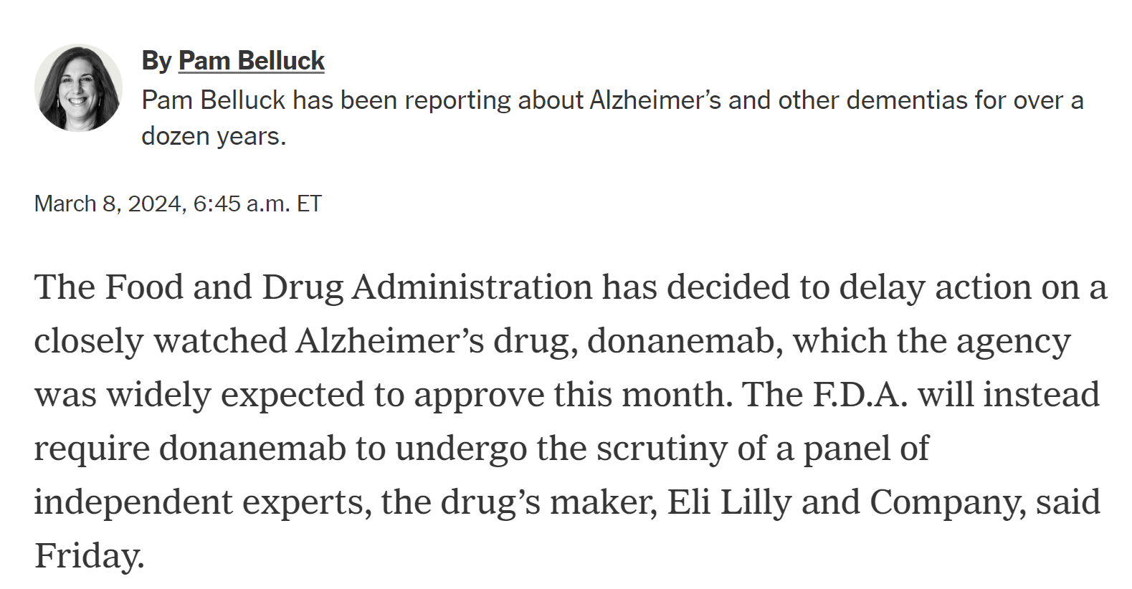
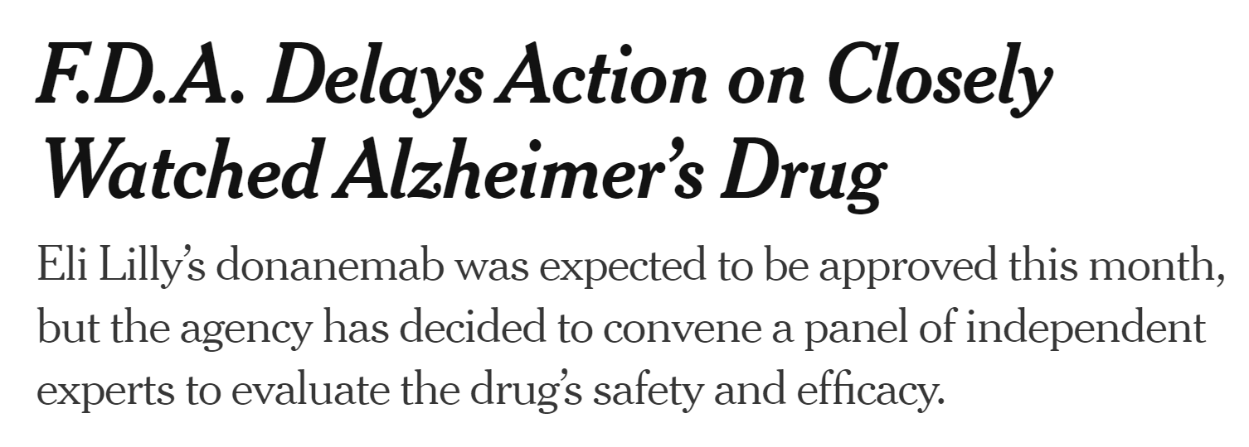
https://www.nytimes.com/2024/03/08/health/alzheimers-drug-donanemab.html

Slide 87
Wrapping up
It’s time to stop using “statistical significance” as any kind of metric for scientific inference, and teaching it as a foundational concept
We and many others have written a lot about what “a world beyond P<0.05” should look like
P-values still have their uses

Slide 88
“(S)cientists have embraced and even avidly pursued meaningless differences solely because they are statistically significant, and have ignored important effects because they failed to pass the screen of statistical significance…It is a safe bet that people have suffered or died because scientists (and editors, regulators, journalists and others) have used significance tests to interpret results, and have consequently failed to identify the most beneficial courses of action.”
(Rothman, supplement to the 2016 ASA statement)

Slide 89
Thanks for your time and attention!
Please send comments to ron@amstat.org.
And remember the disclaimer!

